Slide 1
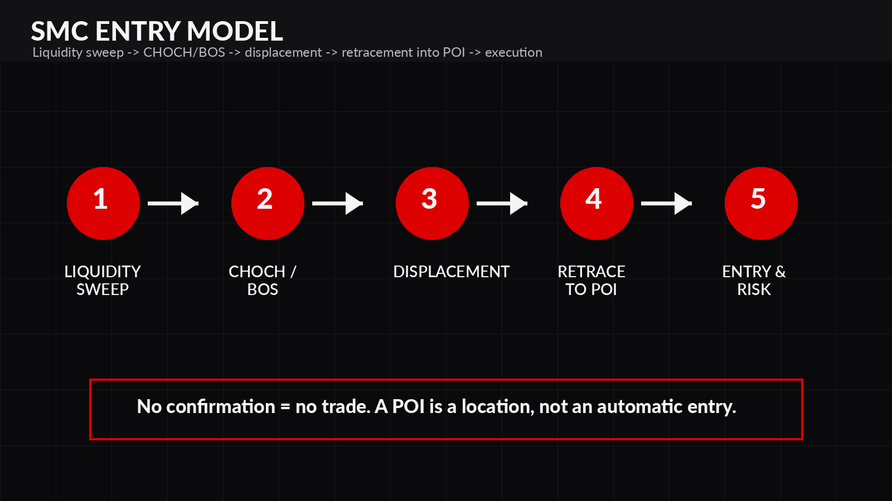
SMART MONEY
CONCEPTS
Structure • Liquidity • POIs • Execution
Educational slide deck built from the SMC guide
RULE: NEVER TRADE A SINGLE CONCEPT IN ISOLATION
TDT | SMC EDUCATION
01

Slide 2
HOW TO USE THIS TRAINING
Study one concept, mark it on charts, then move to the next lesson.
STUDY FLOW
Watch the lesson once without trading it live.
Mark 10 examples on replay or screenshots.
Build a simple checklist before adding risk.
Review mistakes before moving to the next concept.
LEARN
MARKUP
BACKTEST
EXECUTE
JOURNAL
Knowledge first. Execution second. Consistency follows.
Do not rush: one concept, one chart, one rule at a time.
TDT | SMC EDUCATION
02

Slide 3
SMC ROADMAP
The full sequence before a trade idea becomes a setup.
01 Structure
02 Liquidity
03 BOS / CHOCH
04 Displacement
05 FVG / OB
06 POI
07 Premium / Discount
08 Entry
09 Risk
A setup is strongest when multiple pieces of evidence stack in the same location.
TDT | SMC EDUCATION
03

Slide 4
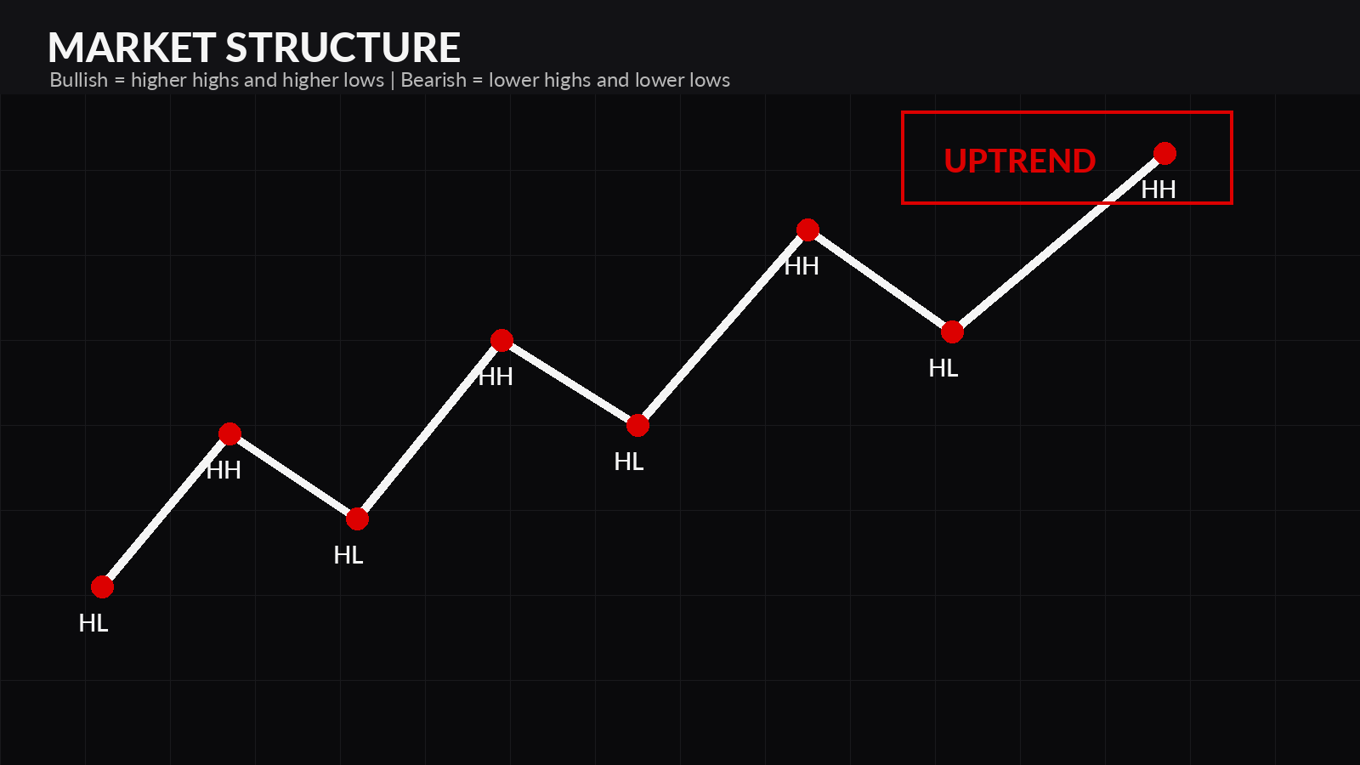
1. MARKET STRUCTURE
Structure shows whether buyers or sellers control the auction.
Bullish: Higher Highs + Higher Lows.
Bearish: Lower Lows + Lower Highs.
A clean break supports continuation.
Context matters: use meaningful swings, not random noise.
Question: Is price building, breaking, or reversing structure?
TDT | SMC EDUCATION
04

Slide 5
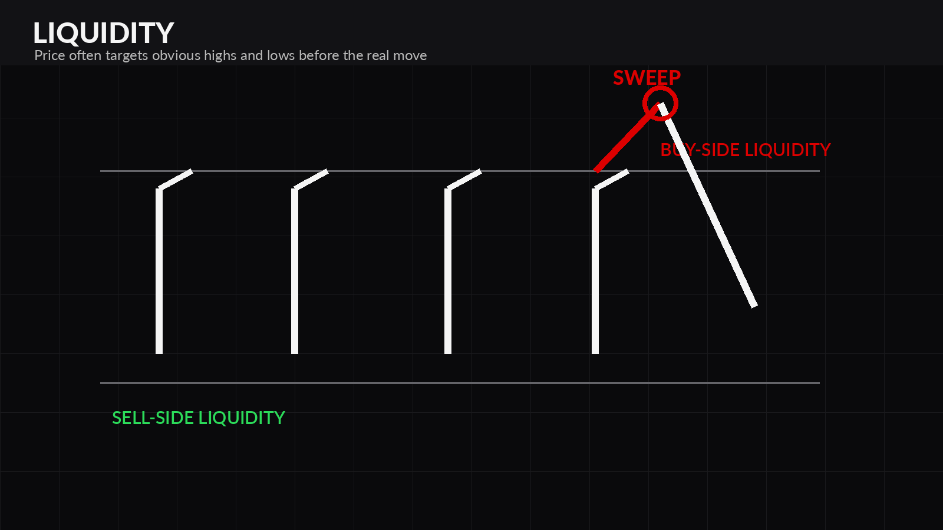
2. LIQUIDITY
Obvious highs and lows often attract orders before expansion.
Buy-side liquidity rests above highs.
Sell-side liquidity rests below lows.
A sweep trades through a level and rejects back inside.
A true breakout shows acceptance, displacement and follow-through.
Liquidity gives price a reason to move before the move.
TDT | SMC EDUCATION
05

Slide 6
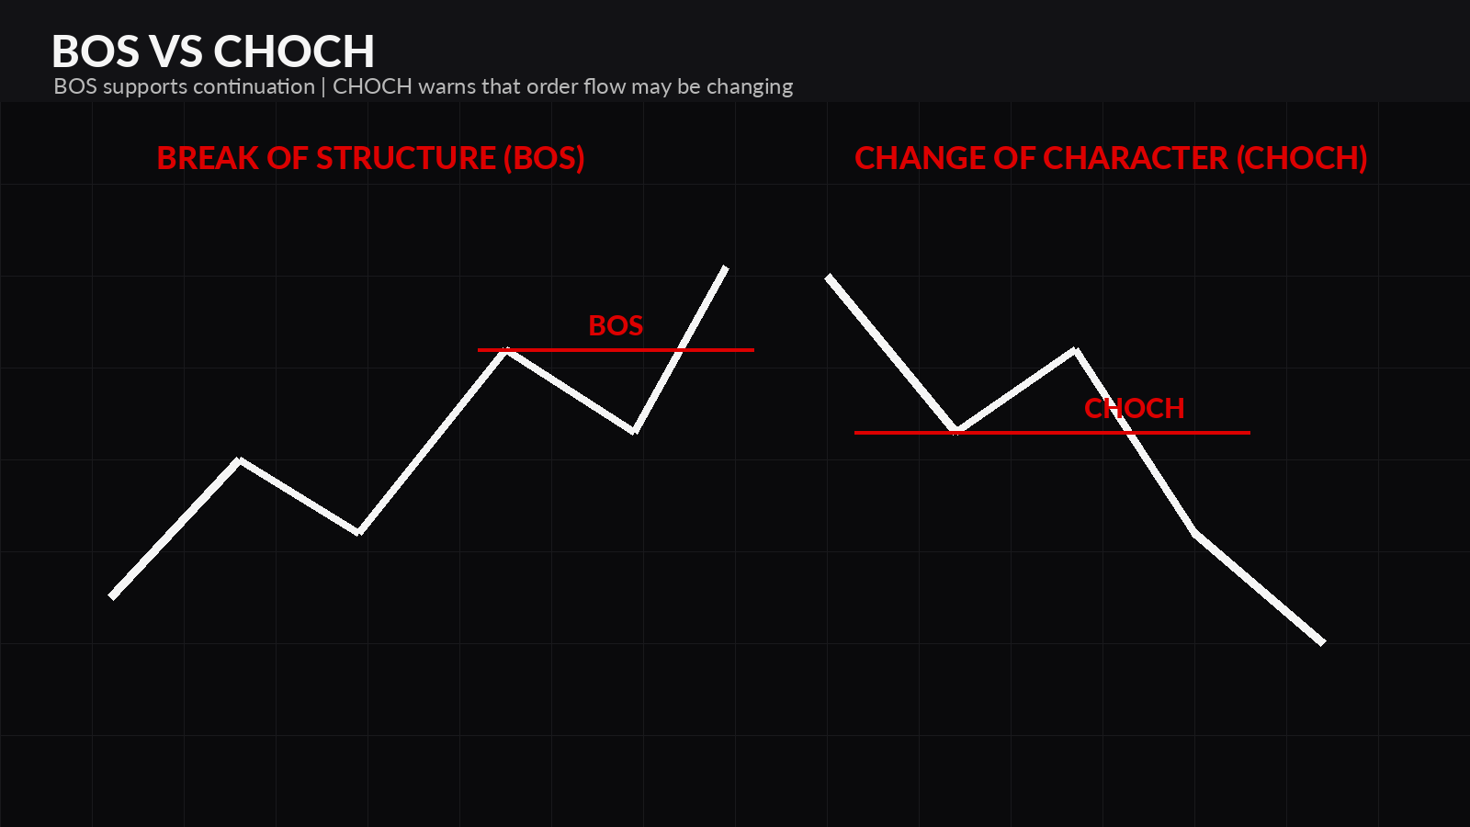
3. BOS AND CHOCH
Use structure breaks to separate continuation from possible reversal.
BOS: price closes through structure in the trend direction.
CHOCH: price breaks against the current trend.
CHOCH is an early warning, not an automatic entry.
Quality improves when the break is supported by displacement.
BOS = continuation. CHOCH = possible control shift.
TDT | SMC EDUCATION
06

Slide 7
4. DISPLACEMENT
Displacement is evidence that aggressive participation entered the market.
Large candle bodies relative to recent candles.
Limited overlap and decisive closes.
Breaks meaningful structure.
Often leaves an imbalance behind.
Follow-through matters more than one impulse candle.
QUALITY CHECK
1. Aggressive candle bodies
2. Break of a meaningful swing
3. Imbalance left behind
4. Follow-through, not instant retrace
TDT | SMC EDUCATION
07

Slide 8
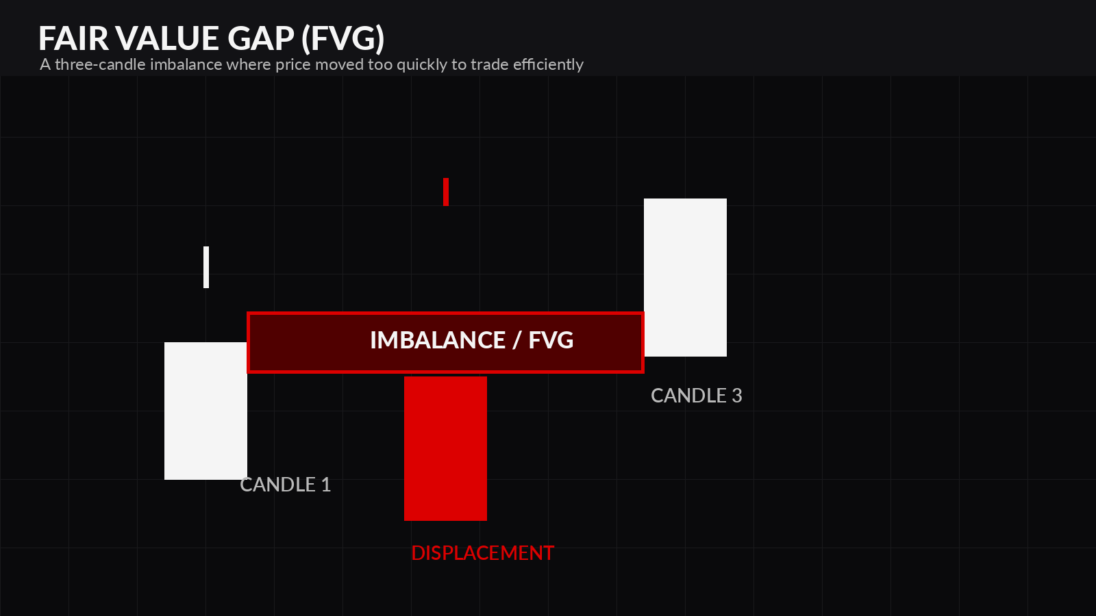
5. FAIR VALUE GAPS
An FVG marks an imbalance created by aggressive movement.
Formed when candle 1 and candle 3 do not overlap.
Stronger when created during displacement.
Higher value when it causes BOS or CHOCH.
Needs enough room to the next target for solid R:R.
Grade the FVG by origin, structure, location and target room.
TDT | SMC EDUCATION
08

Slide 9
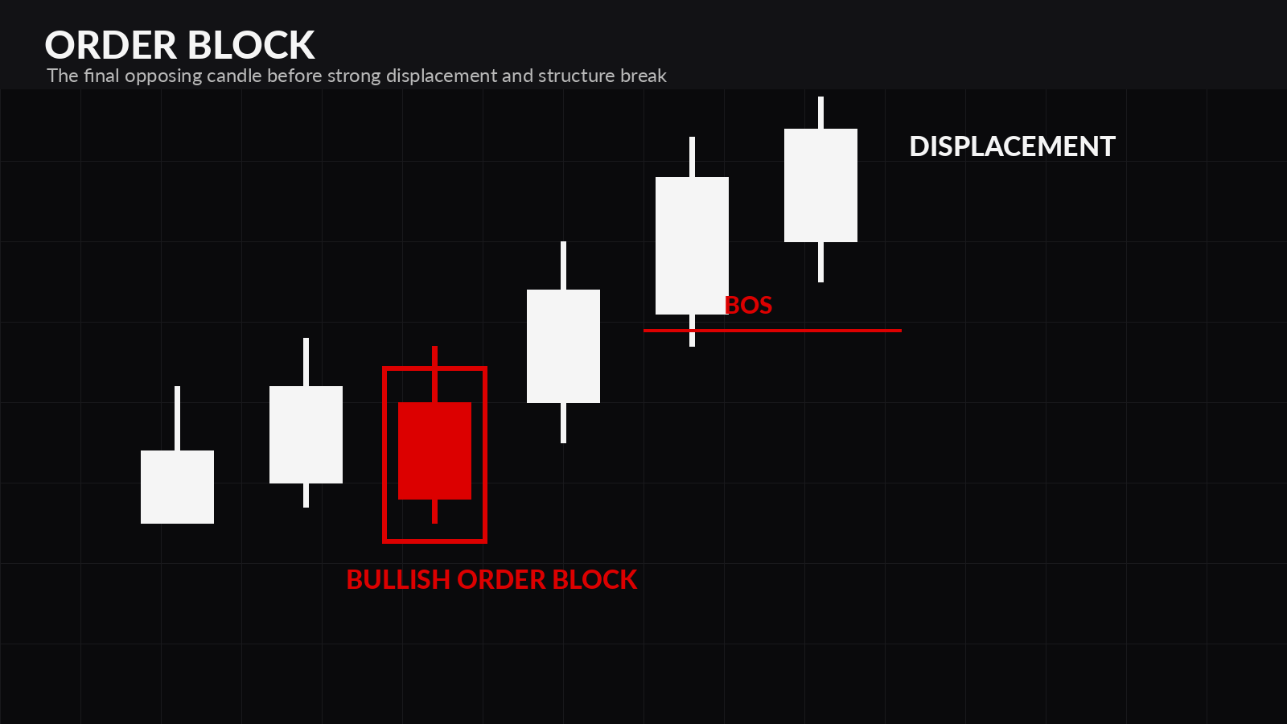
6. ORDER BLOCKS
The last opposing candle before displacement can act as a reaction zone.
Bullish OB: final bearish candle before bullish displacement.
Bearish OB: final bullish candle before bearish displacement.
Valid OBs break meaningful structure.
Fresh zones and clear invalidation matter.
Do not call every candle an order block. Validate the reaction.
TDT | SMC EDUCATION
09

Slide 10
7. POINTS OF INTEREST
A POI is a location where multiple forms of evidence overlap.
Higher-timeframe alignment.
Fresh order block or imbalance.
Nearby liquidity sweep.
Structure shift or continuation BOS.
Premium / discount alignment.
Clear target and invalidation point.
POI RANKING
LOCATION
REACTION
CONFIRMATION
RISK
High-quality POIs stack confluence. Low-quality POIs are just rectangles.
Ask: Why should price react here, and where am I wrong?
TDT | SMC EDUCATION
10

Slide 11
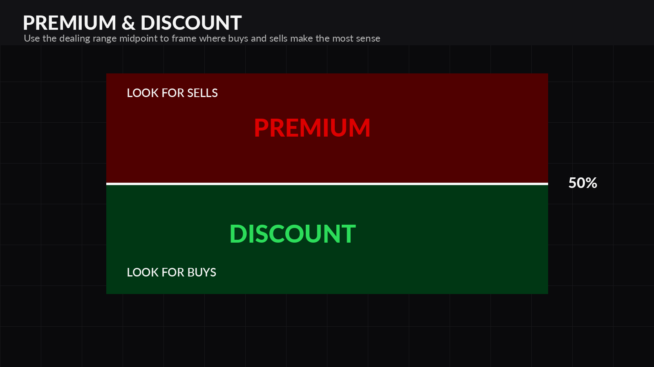
8. PREMIUM AND DISCOUNT
Frame the current dealing range before choosing buy or sell locations.
Mark a meaningful swing low and swing high.
Midpoint = equilibrium.
Bullish narrative: prefer buying in discount.
Bearish narrative: prefer selling in premium.
Context matters during strong trends.
Premium / discount is a filter - not a signal by itself.
TDT | SMC EDUCATION
11

Slide 12
9. SMC ENTRY MODEL
Build a sequence. Do not enter because price touched a rectangle.
Set higher-timeframe bias.
Mark likely liquidity target.
Wait for sweep or reaction.
Confirm BOS / CHOCH with displacement.
Mark OB or FVG from the move.
Enter on a controlled retracement with clear invalidation.
Bias → Liquidity → Reaction → Confirmation → Entry → Management
TDT | SMC EDUCATION
12

Slide 13
10. RISK MANAGEMENT
Your edge is useless if one trade can damage the account.
Risk a fixed percentage or fixed dollar amount per trade.
Place stops where the setup is invalidated.
Calculate position size after defining stop distance.
Do not move stops farther away to avoid taking a loss.
Set daily and weekly maximum loss limits.
POSITION SIZE
Account Risk ÷ Stop Risk = Position Size
Example: $100 max loss ÷ $20 risk per lot = 5 lots
Targets: opposing liquidity, session high/low, major swing or HTF POI
TDT | SMC EDUCATION
13

Slide 14
TRADE CHECKLIST AND JOURNAL
Use this before and after every trade.
HTF bias is clear.
Price is at a meaningful POI.
Liquidity has been identified.
BOS / CHOCH is confirmed by a close.
Entry, stop and target are defined.
Risk is within limits and R:R is acceptable.
JOURNAL PROMPTS
What was the market narrative?
Which liquidity pool was targeted?
Why was the POI valid?
What confirmed the entry?
Did I follow the risk plan?
What would invalidate this setup next time?
Your journal should expose repeatable behavior - not just wins and losses.
TDT | SMC EDUCATION
14

Slide 15
GLOSSARY + NEXT STEPS
Keep definitions simple and consistent, then continue the playlist.
BOS
Continuation break of structure
OB
Zone before displacement
CHOCH
Possible control shift
POI
Location where evidence overlaps
FVG
Imbalance in price delivery
Liquidity
Orders resting near highs/lows
Continue your education:
youtube.com/playlist?list=PLQON0CDxv_Lk
Educational purposes only. This is not financial advice and does not guarantee results.
TDT | SMC EDUCATION
15

